Slide 1
Protocol-Based Computer Reminders, The Quality of Care and The Non-Perfection of Man
McDonald CJ., 1976
CRICOS

Slide 2
Protocol-Based Computer Reminders, The Quality of Care and The Non-Perfection of Man
1
Introduction
2
Materials and Methods
CONTENT
3
Results
4
Discussions
5

Slide 3
Protocol-Based Computer Reminders, The Quality of Care and The Non-Perfection of Man
Medical ignorance
…?
Intrinsic limits
Medical Error
Hypothesis 1: Medical ignorance
Lack of knowledge or awareness about the medical standards, procedures, etc.
Errors caused by it could be eliminated by training or coercion. i.e., “perfectable”
Hypothesis 2: Human Intrinsic limits
Th amount of data presented to the physician per unit time is more than they can process without error
Man is NOT perfectable
Introduction
Methods
Result
Discussion

Slide 4
Protocol-Based Computer Reminders, The Quality of Care and The Non-Perfection of Man
Intrinsic limits
Information theory states that to eliminate such error, one must commit more time to the processing the the relevant data.
rote and repetitive tasks
Computer could help!
Given necessary decision logic (protocols), computer could perform these tasks and thereby provide the necessary processing time.
Regenstrief Medical Record System: a computerized medidal-record system that performs simple informational tasks by protocols
Introduction
Methods
Result
Discussion

Slide 5
Protocol-Based Computer Reminders, The Quality of Care and The Non-Perfection of Man
Regenstrief Medical Record System
Protocol: an English-like statement (written according to prescribed rules) defining a specific clinical event and the suggestions of action necessary to “correct” that event.
Protocols and events were classified as Type I, II or III according to the suggestions that they triggered.
Three type of suggestions:
Type I: Observe a physical finding or inquire about a symptom
Example protocol: On “cardiac glycosid” then observe “PVC’s/MIN”
Type II: order a diagnostic study
Example protocol: On “K+ wasters” and no “uric” since 1 year ago then order “uric”
Type III: Change or initiate a therapeutic regimen
Example protocol: First “chloroquine” and followed by last “visual acuity” changed less than 20% then consider “chloroquine” as cause of optic damage
Introduction
Methods
Result
Discussion

Slide 6
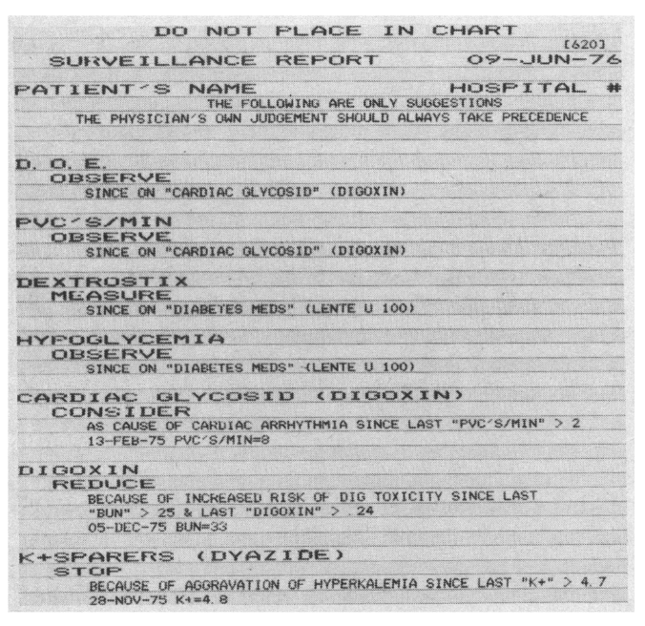
Protocol-Based Computer Reminders, The Quality of Care and The Non-Perfection of Man
Regenstrief Medical Record System
Reports:
Surveillance report All the computer recommendations for a given patient
Computer-tailored encounter form patient’s active prescriptions at the last visit (with Type I recommendations)
Summary report
Introduction
Methods
Result
Discussion

Slide 7
Protocol-Based Computer Reminders, The Quality of Care and The Non-Perfection of Man
Research Aims
Previous Study has proved Regenstrief system significantly reduced the physician’s error rate. However,
Did not prove Hypothesis 2: Human Intrinsic limits is the cause of medical error
Lack of generalization ability: - in a clinical setting with little continuity of care
Protocols used were simple and imprecise
This Paper
Aims to test the Hypothesis 2
To learn whether the protocols can be made more applicable
used a crossover design and more precise protocols in a clinic with continuity of care
Introduction
Methods
Result
Discussion

Slide 8
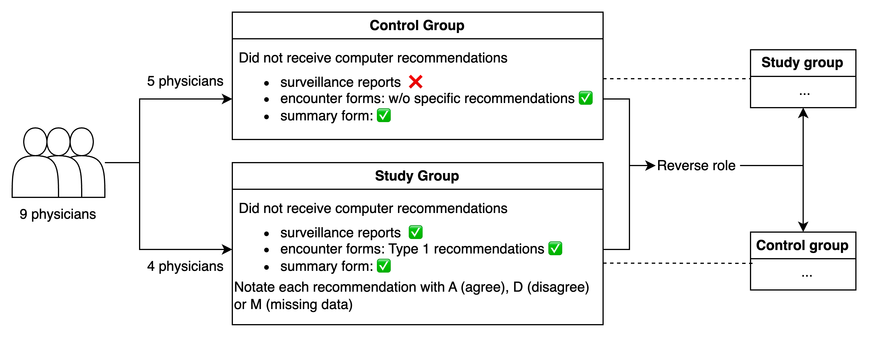
Protocol-Based Computer Reminders, The Quality of Care and The Non-Perfection of Man
Research Methods
Location: General-medicine clinic at Wishard Memorial Hospital
Time period: Nine half-day sessions initiating on March 1, 1975
Protocols: 390 protocols primarily adressing conditions managed or cased by drug
Continuity of care: Each physicians sees a fixed population of patients a half a day per week
Crossover design: Each physician served as his own control in a crossover design
Introduction
Methods
Result
Discussion

Slide 9
Protocol-Based Computer Reminders, The Quality of Care and The Non-Perfection of Man
Research Methods
Response rate: $\frac{\# events in study to which physician responded}{\# events occuring during study}$
The effect of the computer recommendations was measured by the difference between response rate between study events (with computer recommendations) and control events (without recommendations).
Introduction
Methods
Result
Discussion

Slide 10
Protocol-Based Computer Reminders, The Quality of Care and The Non-Perfection of Man
712 computer detected events needing attention
Control Group: 385 events
Response Rate: 22%
Study Group: 327 events
Response Rate: 51%
Summary Results
Each physician responded to a greater percentage of events when given computer recommendations then when not
Response rate: control events vs. study events
Least effect: 35% vs. 53% (by an intern)
Greatest effect: 25% vs. 71% (by a 2nd year resident)
Agreement rate: 86% suggestions have been noted
Agreement: 65%
Disagreement: 20%
Missing data: 15%
77% physician agreement with the protocol logic
Introduction
Methods
Result
Discussion

Slide 11
Protocol-Based Computer Reminders, The Quality of Care and The Non-Perfection of Man
Results Analysis
Three factors that might have influenced outcomes
The type of the event
The level of physician training
The order in which physicians served as study and control subjects
Introduction
Methods
Result
Discussion

Slide 12
Protocol-Based Computer Reminders, The Quality of Care and The Non-Perfection of Man
Result Analysis -- Factor 1: The type of the event
 | Control Group |  |  | Study Group
 | # event occurring during study | # event to which physician responded | Response Rate | # event occurring during study | # event to which physician responded | Response Rate
Type I event | 163 | 30 | 18.40% | 153 | 66 | 43.14%
Type II event | 165 | 37 | 22.42% | 119 | 72 | 60.50%
Type III event | 57 | 17 | 29.82% | 55 | 18 | 32.73%
The computer-generated suggestions significantly influenced physician responses across all three event types (P values for Type I, II, III: **, ***, **)
Suggesting a pervasive and consistent influence on the physician’s decision-making process
Introduction
Methods
Result
Discussion

Slide 13
Protocol-Based Computer Reminders, The Quality of Care and The Non-Perfection of Man
Result Analysis -- Factor 2: The level of physician training
9 physicians
4: second-year residents
4: interns
1: first-year resident
Overall impact of training level: No significant effect on results
Significant Interactions detected:
Within study events:
Interns responded more frequently than residents to Type II event (P***)
Residents responded more frqeuntly than interns to Type I events (P*)
Within control events:
No significant differences in response rates between interns and residents for any event type.
Introduction
Methods
Result
Discussion

Slide 14
Protocol-Based Computer Reminders, The Quality of Care and The Non-Perfection of Man
Result Analysis -- Factor 3: The order in which physicians served as study and control subjects
Training effect: Physicians who were exposed to computer suggestions first (in first study group) are expected to be “trained” by the computer
There was no overall difference between the results for physicians whose control period was first and those whose control period was second.
Introduction
Methods
Result
Discussion

Slide 15
Protocol-Based Computer Reminders, The Quality of Care and The Non-Perfection of Man
Discussion
This Paper
Aims to test the Hypothesis 2: Human Intrinsic limits is the cause of medical error
To learn whether the protocols can be made more applicable
used a crossover design and more precise protocols in a clinic with continuity of care
Key Findings:
Overall, physicians detected and responded to twice as many events when given computer recommendations as when not (51% vs. 22%)
This effect was seen in every physicians and was of similar magnitude for physicians in different training level
This effect was seen in all event types (Type I, II, III)
Introduction
Methods
Result
Discussion

Slide 16
Protocol-Based Computer Reminders, The Quality of Care and The Non-Perfection of Man
Discussion
Test the Hypothesis 2: Human Intrinsic limits is the cause of medical error
Hypothesis 1: Medical ignorance
Not supported in this study
No “training effect” was seen
The base-line (control) response rate were similar between physicians in different training level
Medical ignorance
Selfish motive
Intrinsic limits
Clinical Error
Hypothesis 2: Human Intrinsic limits
Findings were consistent with this hypothesis
The computer augments the physician’s capabilities and thus reduces their error rate
Introduction
Methods
Result
Discussion

Slide 17
Protocol-Based Computer Reminders, The Quality of Care and The Non-Perfection of Man
Discussion
To learn whether the protocols can be made more applicable
This study was performed in a continuous-care setting with 390 more precise protocols
The results shows that effect of computer-generated suggestions extends to at least some continuous-care setting
Physicians comply with a higher proportion of computer recommendations when protocols are more precise (51% vs. 35%)
Introduction
Methods
Result
Discussion

Slide 18
Protocol-Based Computer Reminders, The Quality of Care and The Non-Perfection of Man
Discussion
“Though the individual is not perfectable, the system of care is, and that the computer will play major part in the perfection of future care systems.”
rote and repetitive tasks
Half a century later, is the system of care perfectable?
More precise protocols?
Blackbox AI without predefined protocols?
Introduction
Methods
Result
Discussion

Slide 19
Protocol-Based Computer Reminders, The Quality of Care and The Non-Perfection of Man
Thank you!

